Slide 1


Banking Marketing Targets
By Jump-start

Slide 2


About Us
Jump-start is a Data Scientists team. We are tasked to help analyze and provide solution for problems in the direct marketing campaign of a Portuguese Banking Institution.
Our Data Scientist Team
Maghfira Amalia
Mahendra Prabaswara
Ridwan Donovan
Windy Nurfikri
1

Slide 3

Banking Marketing Targets
Term deposits are one of the major income sources of a bank. These days, selling deposits through telemarketing is still the main of various plans to reach out to the clients. However, the bank still needs to pay attention to the effectiveness of the direct campaign considering the high cost and the time it takes. Based on previous campaign data of 45,211 clients, only 11.7% of them actually subscribed to a term deposit. Despite the fact that 36,959 clients were never contacted. Therefore, determining the right potential depositors needs to be done to save resources. Meanwhile, we also need to review the efficiency and effectiveness of telemarketing as a direct campaign method.
45,211
CLIENTS
11.7%
SUBSCRIBED
36,959
NEVER CONTACTED
2

Slide 4

Goal
Increase the efficiency and effectiveness of direct campaign
Objectives
Predict the potential depositor by classifying them (based on their background and financial history)
Find out the success rate of telemarketing as direct campaign method
Business Metric
Conversion Rate
Your logo
3

Slide 5

Exploratory
Data Analysis
Your logo
4

Slide 6




Dataset
Customer Profile
Feature
Target
Data Information
Age
Job
Marital Status
Education
Default
Balance
Housing
Loan
Contact
Day
Month
Duration
Campaign
pdays
Previous
poutcome
Depositor
45211 rows
17 columns
Balance, Duration, and Pdays have a lot of outlier data
All numerical features have uneven distribution values
More than 75% of previous campaign is unknown
Most of features has weak correlations
5

Slide 7
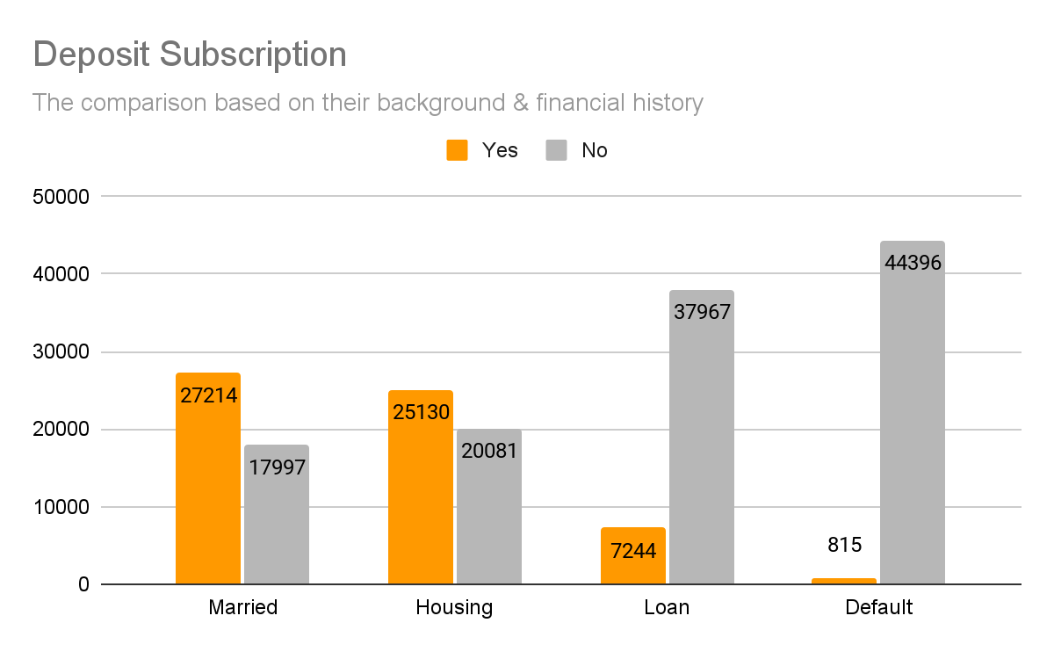
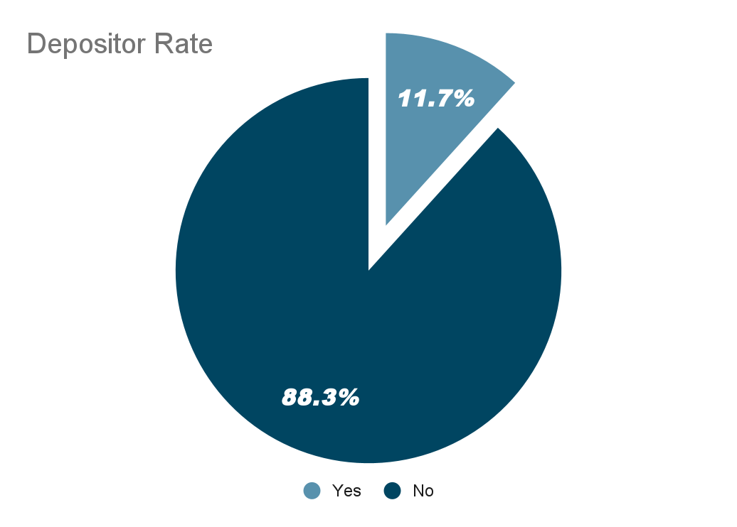
Analyze Each Feature
According to the data provided by the Portuguese Bank Institute, there are still 88.3 % of the total customers have not subscribe to the deposit from the previous campaign. The majority of the customer did not take any types of loan.
7

Slide 8
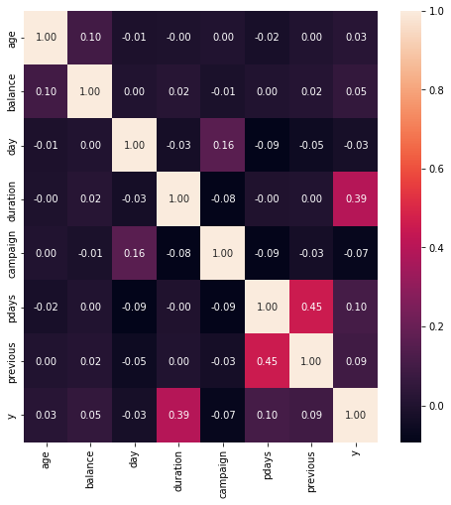
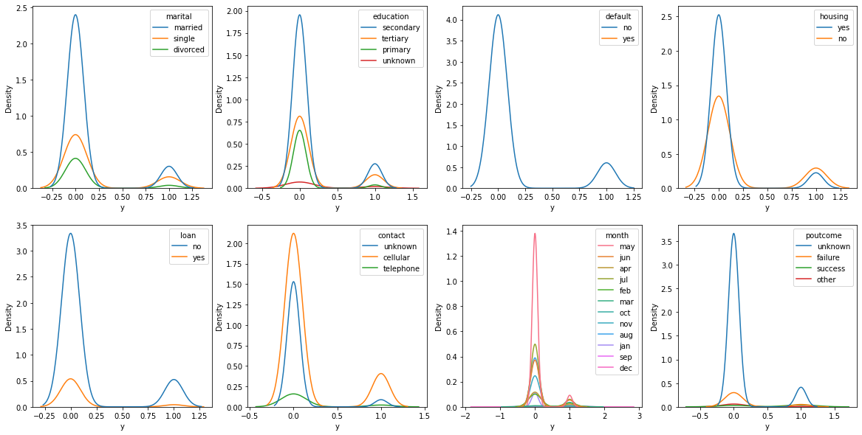
Analyze Feature Correlation
only duration that have strong correlation with y (target)
8

Slide 9
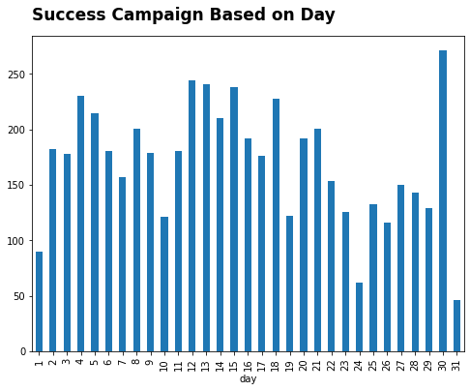
A positive campaigns outcome (customers subscribed to deposit) rarely occur at the end of the month, except on the 30th, which is estimated to be a pay day.
And most of it occurred at middle of the month.
9

Slide 10

Data Preprocessing
10

Slide 11

Missing Data
Duplicated Data
Handling Outliers
Features Transformation
Feature Encoding
Feature Engineering
Class Imbalance
No Missing Data
No Duplicated Data
Handling the Outliers Manually
No Feature Transformation
Label Encoding & One-hot Encoding
Selecting, Extracting and Adding a feature that related to the case
Handled by oversampling using SMOTE method.
the transformation are constrained by zero value and negative value
11

Slide 12
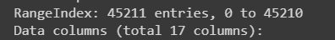
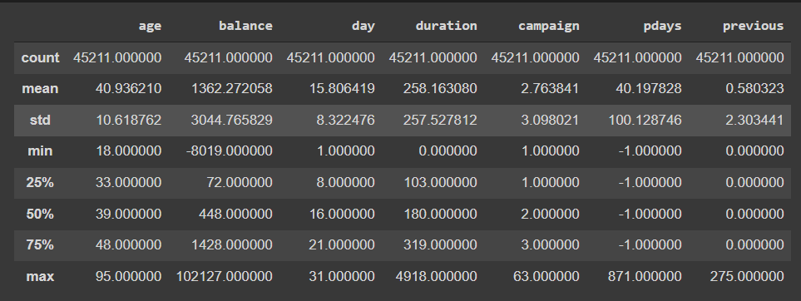
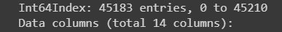
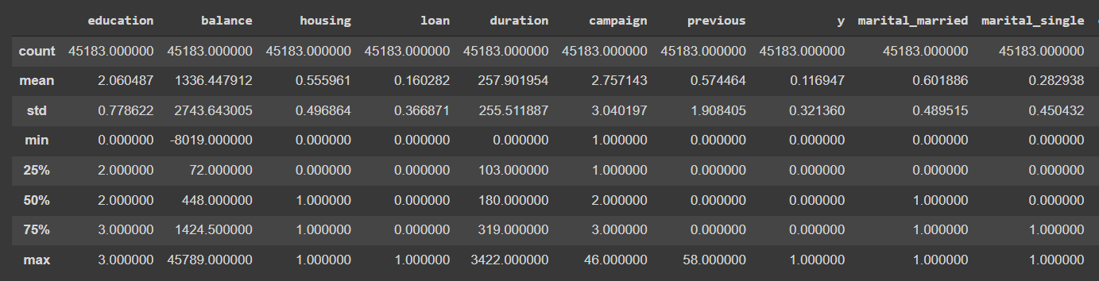
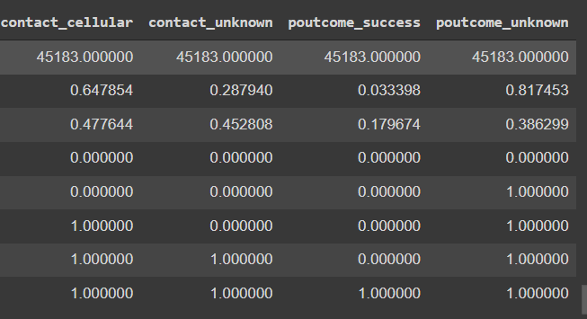
Before Data Processing
After Data Processing
13

Slide 13

Model & Evaluation
Your logo
14

Slide 14
Machine Learning Purpose
To giving recommendation about Depositor acquisition
Considerations of Algorithm Selection:
To Classify Customer
Imbalance Data
15

Slide 15
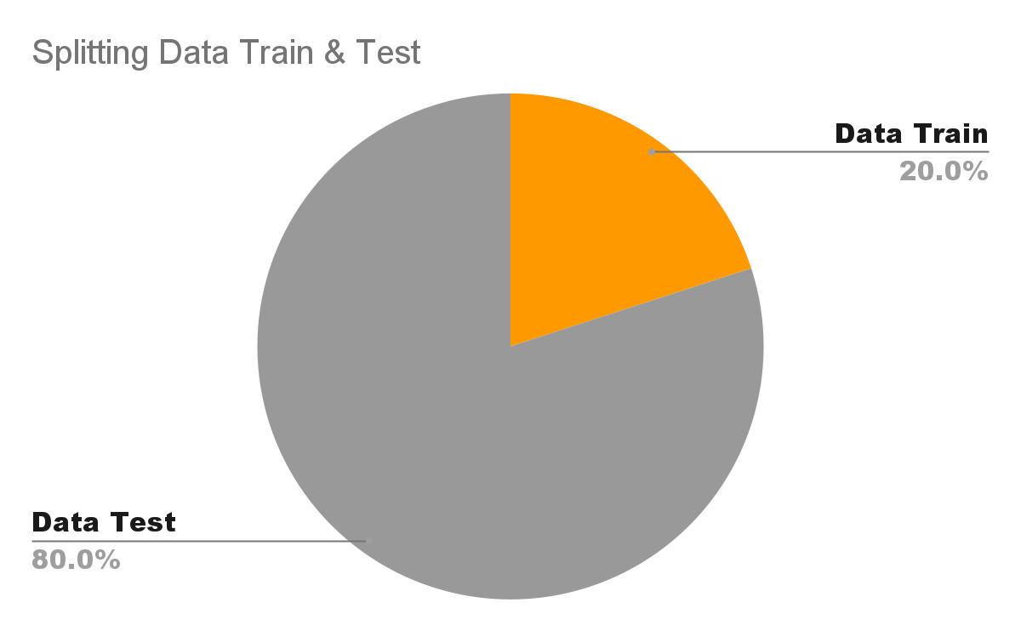

Hyperparameter Tuning
Random state : 42
Model : RandomForest
Scoring : F1
 | Accuracy | Precision | Recall | F1 Score | Train_score | Test_score
Decision Tree | 89.1% | 88.04% | 90.65% | 89.32% | 99.99% | 89.1%
Random Forest | 91.61% | 90.59% | 92.97% | 91.77% | 99.99% | 91.61%
Gradient Boosting | 89.2% | 88.95% | 89.95% | 89.34% | 89.67% | 89.2%
16

Slide 16
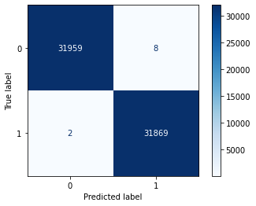
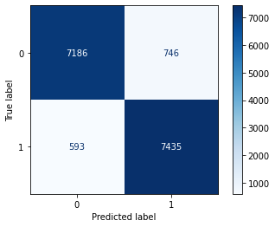
Confusion Matrix
Train
Test
17

Slide 17
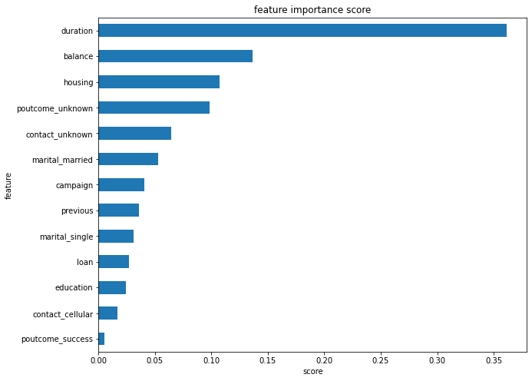
Feature Importance
18

Slide 18
Behaviour of Potential Depositor
Average duration is 9 minutes
Average balance is 1800
19

Slide 19

Business Recommendation
20

Slide 20

Based on the result of evaluating and insight from the given data by the portuguese bank institute. In order to make the direct campaign more effective, there are several points need to be improve:
Train communication skill to telemarketer so can provoke customer’s curiosity for the Deposit product and also maintain the duration of the conversation to average about 9 minutes.
Focus on customer with balance above 1800
Know telemarketing target precisely based on information of profile, then can emphasized on what benefit the customer can get by their background when calling them.
Reach out client at middle of the month or pay day.
Do follow up after telemarketing is done
21

Slide 21
Thank You

